Slide 1
Counting Balls in Nets: A Prediction of German Goals in the 2018 World Cup
Michael Siebel

Slide 2
Background
Moneyball: The Art of Winning an Unfair Game (2003)
By Michal Lewis
Baseball statistics on player performances
Statistical techniques over coaches, scouts, journalists, and pundits expertise
Soccernomics (2009)
By Simon Kuper and Stefan Szymanski
Soccer statistics on team performances
Fluid gameplay does not lend itself well to statistics
Research tends to make more use of Bayesian priors

Slide 3
Objective
Predict goals from last tournament’s winners (Germany)
2010 World Cup was one of the lowest scoring
2014 World Cup was one of the highest scoring
Germany had high goal scoring totals in both
16 in 2010 WC
18 in 2014 WC
Scored 43 in 10 games during qualifying
Germany has played Mexico (June 17) and Sweden (June 23)

Slide 4
Data
Three datasets:
International Soccer matches from 1872 to 2018
FIFA rankings from 1993 to 2018
Upcoming FIFA World Cup 2018 match fixtures
Created primarily from webscrapping from Wikipedia, fifa.com, rsssf.com, and individual football associations' websites
Posted on Kaggle
Main final dataset contained goals scored by Germany from 1950 to 2018
Level of analysis: Matches
Unit of analysis: Goals

Slide 5
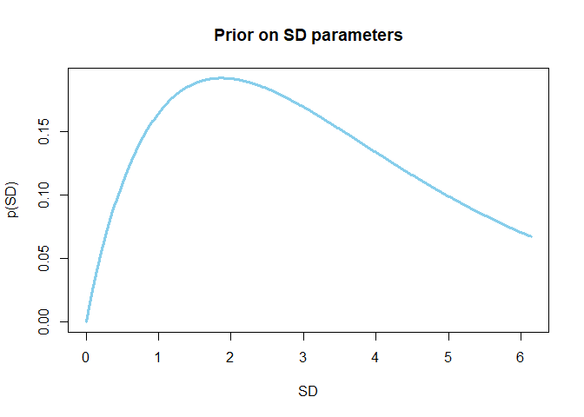
Methodology
Using count data (goals)
Goals tend to crowd around 1 and rarely go above 5
Fits a Poisson distribution
Using a Generalized Linear Model with a Poisson link function
Aiming to generate predicted probabilities for goal counts
Bayesian model (MCMC) will use median average Germany goals since 1950 as a prior
Germany scored an average of 1.14 goals
This is low compared to recent years
Will compare results with Frequentist modeled predicted probabilities

Slide 6
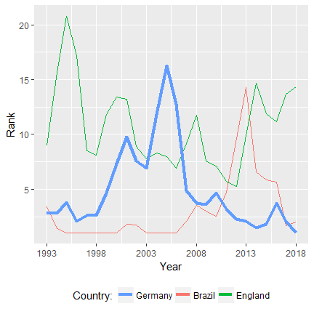
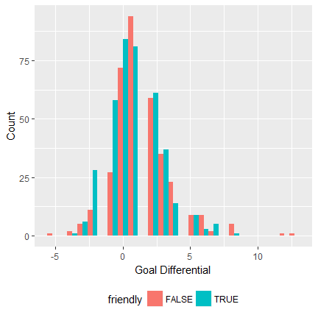
German Performance
Germany is normally highly ranked (low on the y-scale)
Germany’s goal differential is largely positive
Outliers give it a right skew
Could have potential used goal differential in a linear regression
Average goals is low but not too heavily concentrated around zero
Good candidate for Poisson regression

Slide 7
Independent Variables
Win ratios
International teams play each other infrequently
Every two world cup campaigns (8 years) and current campaign (4 years) was averaged
Higher win ratios are likely associated with more goals
Opponents were factorized
Germany plays well against England
Germany plays poorly against Italy
Binary variable on whether match was “Friendly” or “Competitive”
Goals are generally higher in friendlies
Many games are friendlies

Slide 8
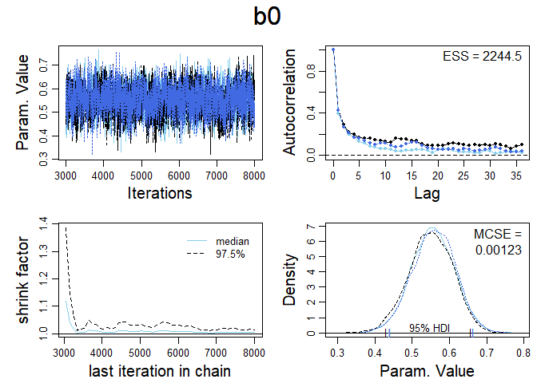
Diagnostics
Only showing intercept
Betas and standard deviations were similar
No major divergent transitions
No issues with converging
Good shrinkage
Gibbs sampling is normally recommended
Had good diagnostics with only 15,000 steps
Low dimensions
Did not use Gibbs sampling

Slide 9
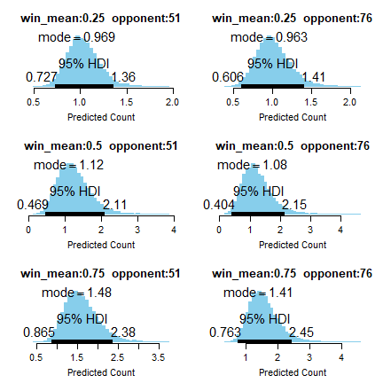
Results
Opponent “51” is Mexico; Opponent “71” is Sweden
Bayesian model
Germany had predicted probability of 1.12 and 1.08 goals against Mexico and Sweden, respectively
High credibility intervals (0.47-2.11 and 0.40-2.15)
Frequentist model
Germany had predicted a probability of 2.12 and 1.95 goals against Mexico and Sweden, respectively
Actual results
Scored 0 against Mexico
Scored 2 against Sweden

Slide 10
Conclusion
Bayesian model was more conservative
Used low, historic median goals of 1.14 as prior
Betting odds would likely made it more aggressive than Frequentist
Model’s are generally weak
Credibility interval is large
Low sample of tournament play with current team
Use of prior will have a large effect

